Slide 1
Project Presentation of Industry Oriented Hands on Experience (22CS422)
On
Impact of Caching Strategies on Large-Scale Backend Application Performance
Submitted By:
Vansh Tomer (2210994857
Yuvraj Prajapat (2210992573)
Supervised By:
Dr. Swati Goel
Associate Professor
Department of Computer Science and Engineering,
Chitkara University, Punjab

Slide 2
Introduction to Backend Catching
What is Caching?
Caching is the process of storing frequently accessed data temporarily to reduce server load and improve response speed.
Importance in Modern Applications
Large-scale applications such as e-commerce, streaming platforms, and social media rely heavily on caching for smooth performance.
Primary Goal
The main objective is to minimize latency, optimize throughput, and enhance scalability.
2

Slide 3
Problem Statement
Repeated Database Queries
Continuous database access for identical requests increases response time and server workload.
High User Traffic
Large numbers of concurrent users can create bottlenecks in backend systems.
Need for Optimization
Efficient caching mechanisms are required to ensure fast and reliable application performance.
3

Slide 4
Research Objectives
Analyze Caching Techniques
Study different backend caching strategies used in modern distributed systems.
Compare Technologies
Evaluate in-memory caching, Redis caching, and cache-aside patterns.
Performance Evaluation
Measure improvements in response time, request handling, and scalability.
4

Slide 5
Methodology
Backend Development
A prototype backend system was developed using Node.js and Express.js.
Testing Environment
Large datasets and simulated user requests were used for realistic performance analysis.
Benchmarking Tools
Autocannon was used to measure throughput, latency, and request performance.
5

Slide 6
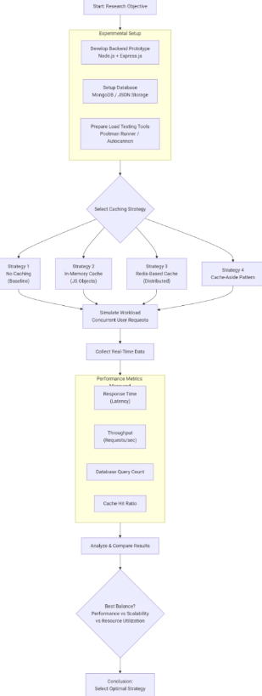
FLOWCHART FOR METHODOLOGY

Slide 7
Types of caching strategies
In-Memory Caching
Stores data directly in server memory for extremely fast retrieval.
Redis Distributed Caching
Uses Redis as an external cache to support scalability across multiple servers.
Cache-Aside Pattern
Loads data into cache only when requested, reducing unnecessary memory usage.
7

Slide 8
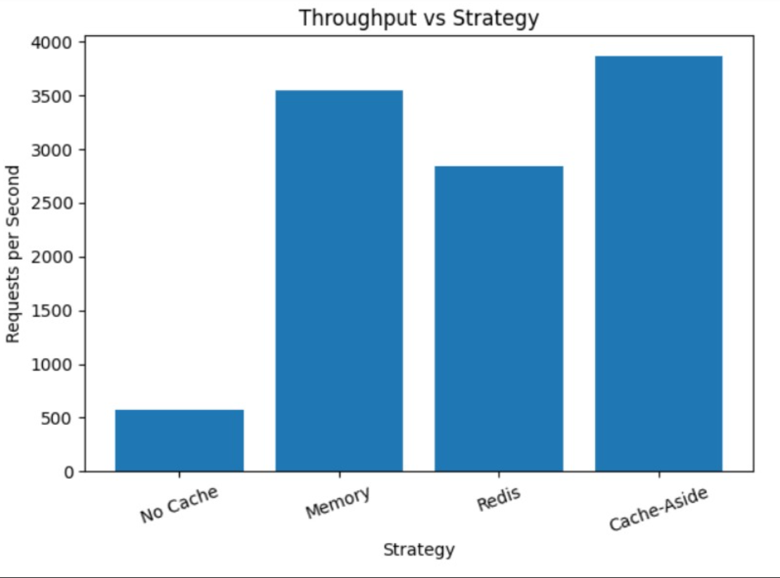
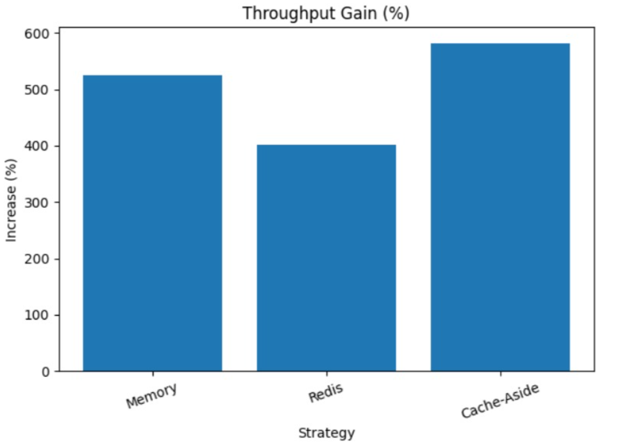
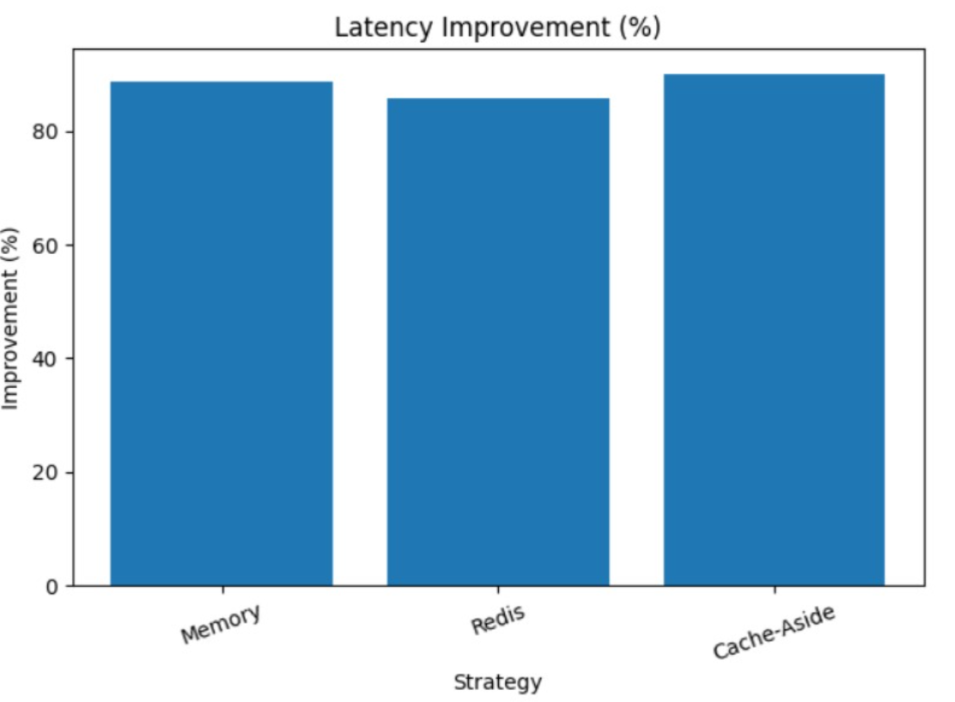
Performance Analysis
Reduced Response Time
Caching significantly decreased API response delays compared to direct database access.
Improved Throughput
The backend handled a larger number of requests per second after caching implementation.
Enhanced Scalability
Redis-based distributed caching performed efficiently under heavy traffic conditions.
8

Slide 9
Advantages of backend caching
Faster Application Performance
Users experience quicker page loads and smoother interactions.
Lower Database Load
Frequent queries are reduced, decreasing pressure on database servers.
Better User Experience
Applications become more responsive and reliable during peak traffic.
9

Slide 10
Challenges and limitations
Cache Invalidation
Managing outdated or stale cache data can be complex.
Memory Consumption
Large caches require efficient memory allocation and monitoring.
Synchronization Issues
Distributed systems may face consistency problems between cache and database.
10

Slide 11
Conclusion
Importance of Caching
Caching is essential for maintaining performance in large-scale backend systems.
Best Performing Strategy
Redis and cache-aside strategies provided strong scalability and efficiency.
Final Observation
Optimized caching significantly improves latency, throughput, and overall application reliability.
11

Slide 12
Thank You
12

